Slide 1
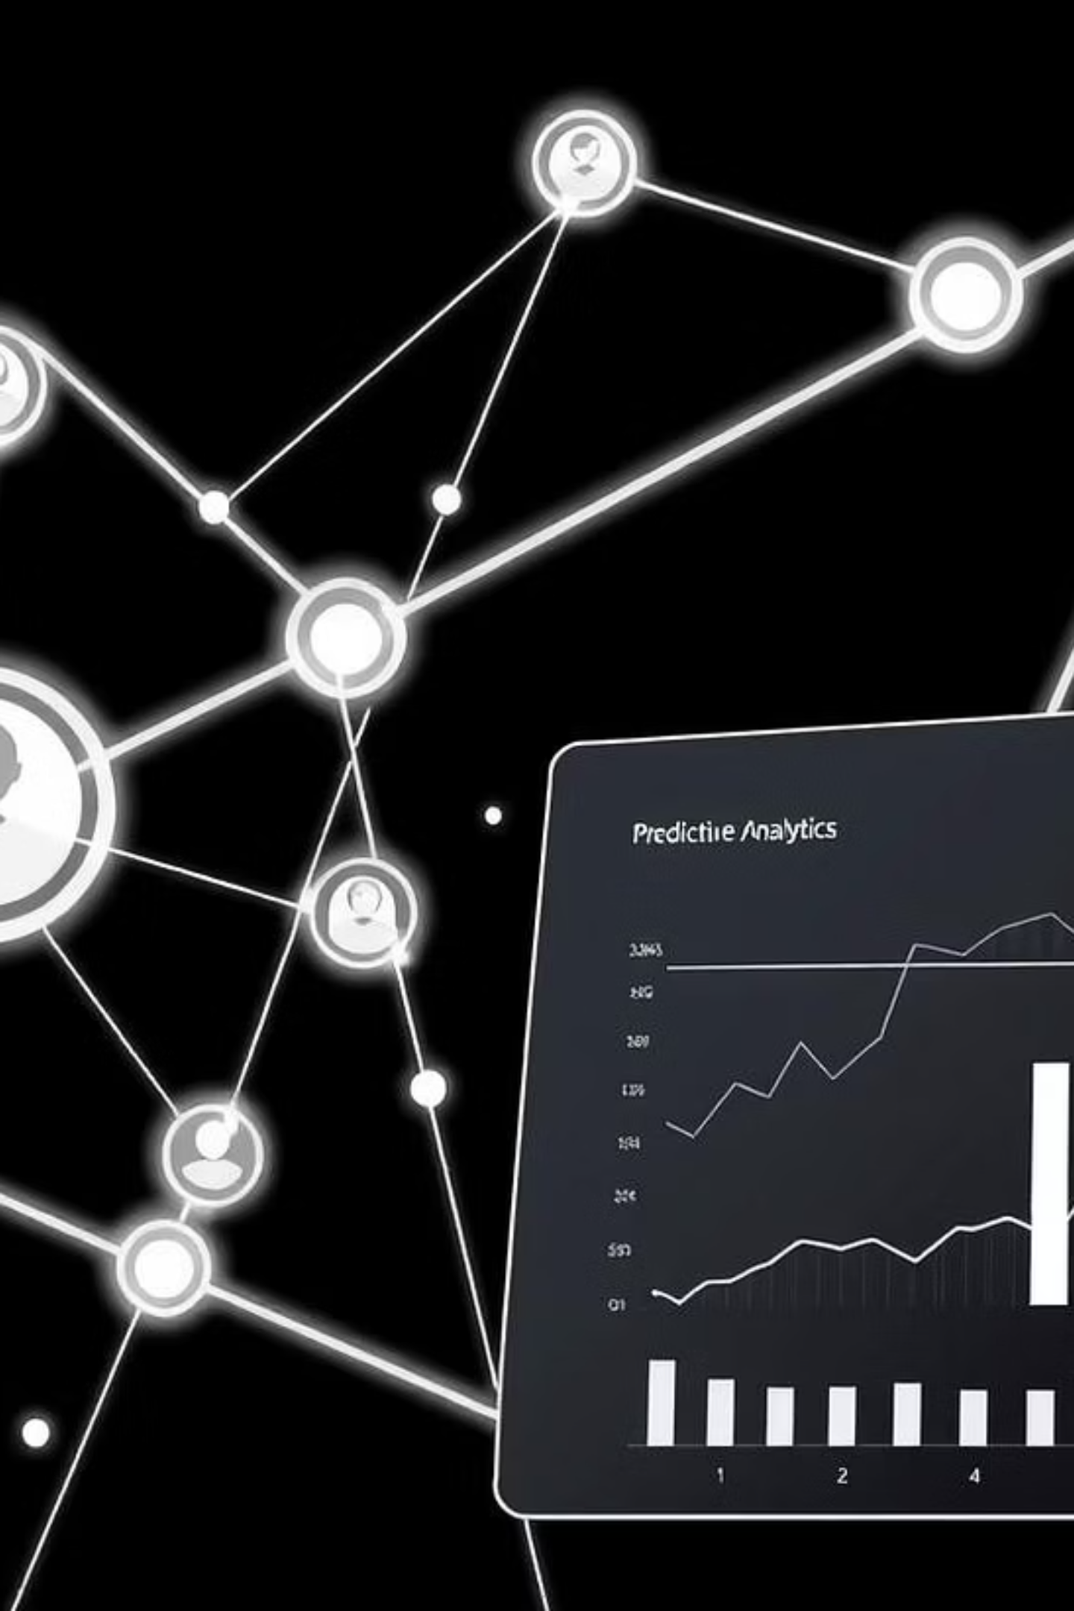
Telecom Customer Churn Prediction System
Proactively identify and retain at-risk subscribers to minimise revenue loss.

Slide 2
Project Overview
The "Telecom Customer Churn Prediction System" addresses a critical challenge in the telecom industry: proactively identifying subscribers likely to churn. By leveraging advanced machine learning, this system empowers service providers to deploy targeted retention strategies, significantly reducing revenue loss and boosting customer satisfaction.
1
2
3
Problem
Solution
Output
Telecom companies face significant revenue loss due to subscriber churn. Manual analysis is infeasible at scale, necessitating an automated prediction system.
An automated system that predicts churn risk using customer demographics, service details, and billing metrics, enabling timely interventions.
Provides both a churn probability score and a clear yes/no prediction, allowing business users to prioritise and tailor retention efforts.

Slide 3
Scope and Objectives
Our project focuses on developing a comprehensive machine learning pipeline and web interface for churn prediction, ensuring reproducibility and ease of deployment.
Scope
Objectives
End-to-end ML pipeline with preprocessing and feature engineering.
Data Preparation & Exploration: Clean data, identify churn drivers.
Supports single record (online form) and bulk record (CSV upload).
Model Development: Evaluate and optimise classification algorithms.
Encapsulates all data transformations within a serialized pipeline.
Pipeline Serialization: Bundle preprocessing and model for production.
Provides binary churn flag and probability score for business use.
Web Application Deployment: Flask app for predictions via UI/API.
Business Insight Delivery: Document performance and feature importances.

Slide 4




System Architecture and Data Flow
Inputs
User Fills Online Form (demographics, services, billing).
CSV Batch Upload (for bulk scoring).
Customer data collection for prediction initiation.
Processing
Missing Value Handling (imputation/filtering).
Type Conversion & Scaling (numeric features).
Categorical Encoding (one-hot encoding).
Transformation of raw inputs into model-ready features.
Prediction
Pipeline Execution (loads serialized ColumnTransformer + XGBClassifier).
Probability & Class Computation (churn probability and binary label).
Application of the trained pipeline to compute churn risk.
Output
Single Row Response (web page display: "Churn Risk: Yes/No", "Probability: xx.xx%").
Batch Mode Response (downloadable CSV with appended "Churn_Prediction" and "Churn_Probability").
Delivery of actionable results to the user.

Slide 5






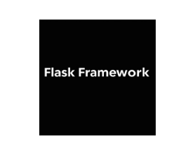



Implementation Methodology
Key Stages
Tools Used
Data Preprocessing & Feature Engineering: Cleaning, handling missing values, encoding, and scaling data.
Model Training & Tuning: Stratified train/test split, pipeline construction (ColumnTransformer + XGBClassifier), and hyperparameter optimization via RandomizedSearchCV.
Model Evaluation: Performance metrics (Accuracy, Precision, Recall, F1, ROC AUC) and visual validation.
Pipeline Serialization: Saving the complete pipeline using joblib for production.
System Requirements: Minimum 8GB RAM, Intel i5+, 2GB disk space. Python 3.8+, with libraries like pandas, numpy, scikit-learn, XGBoost, and Flask.
Web App Deployment: Streamlit

Slide 6
Results and Performance
The system effectively predicts churn, demonstrating strong performance and providing actionable insights into key churn drivers.
0.96%
0.98
0.95%
0.96%
Accuracy
ROC AUC
Precision
Recall
Overall correct predictions.
Model's ability to distinguish between classes.
Proportion of true positive predictions.
Proportion of actual positives identified.
Top 5 Churn Drivers
Contract Type: Month-to-Month contracts.
Tenure: Shorter customer durations.
Monthly Charges: Higher recurring fees.
Online Security: Lack of online security add-on.
Tech Support: Absence of technical support.

Slide 7
Challenges Faced and Learnings
We successfully navigated several challenges, reinforcing best practices for robust machine learning system development.
Challenges Addressed
Key Learnings
Class Imbalance: Stratified splits, early stopping, ROC AUC evaluation.
End-to-End ML Lifecycle: Hands-on experience from data cleaning to deployment.
Missing Data: Imputed missing TotalCharges to avoid data loss.
Pipeline Best Practices: Importance of serializing preprocessing with models.
Preprocessing in Production: Serialized pipeline for consistent transformations.
Interpretability Matters: Feature importance guides actionable business strategies.
Scalability & Latency: Model caching and system recommendations for efficiency.
Web Integration: Bridging Python ML with lightweight web frameworks (Flask).
Performance Monitoring: Need to track latency and resource usage in production.

Slide 8
Conclusion and Future Work
The Telecom Customer Churn Prediction System provides a robust, end-to-end solution for proactive subscriber retention.
Summary
Future Enhancements
Delivered an XGBoost-powered system that handles data, predicts churn with high accuracy, and offers a user-friendly interface, enabling proactive retention.
Cloud Deployment & Scaling (Docker, CI/CD).
Real-Time Streaming Inference (Kafka/Kinesis).
Explainability & Monitoring (SHAP/LIME, dashboards).
Enhanced Feature Engineering (network quality, time series).
Personalised Retention Strategies (customer segmentation).
These advancements will evolve the system into a fully managed, explainable, and scalable solution, strengthening customer loyalty and business outcomes.

